Slide 2
We believe people who have been impacted by the system(s) have critical contextual insight into the problems, cultures, and solutions; therefore, we will co-create, partner, acknowledge, and share power with them in all aspects and phases of the work and decisions, and provide equitable compensation and other support as needed/appropriate.
We believe in truth-telling and courageous conversations; therefore, we will hold space to acknowledge harm, embrace other perspectives, and partner together for shared accountability to prevent further harm.
We believe in the importance of data and information to inform and drive solutions; therefore, we will seek and share information to drive solutions that matter to communities.
We believe all families and communities have value and a unique culture; therefore, we are committed to addressing stigma, practicing humility, active listening, and continuous learning from each other.
We believe all families have needs and strengths, and communities are the source of support; therefore, we will invest in authentic relationships to increase well-being so that families can thrive and have what they need when they need it.
Core Values

Slide 3
Commit to attendance and actively participate and contribute while being aware of disparities.
Be respectful and listen with an open mind and be willing to learn and understand all possibilities proposed.
Embrace no blame/no shame with an open mind in an unbiased manner valuing diverse perspectives, experiences, and ideas.
Ground Rules
Every meeting should be focused on achieving the goals and objectives.
Bring knowledge (via science, research, and lived experience) to action.
Recognize and celebrate progress and victory.
Be willing to come to consensus and support the decisions made by the team.

Slide 4
Florida TFSC Vision Statement
To co-create and transform Florida’s systems to develop a statewide culture of child, youth, and family well-being.
Florida TFSC Priorities:
1. Support and strengthen families through community engagement and increased awareness.
2. Establish a foundation for the integration of child and family well-being into the various state systems that address education, health, safety, and economic and housing stability.
3. Promote the formation of Parent Advisory Councils in each jurisdiction across the state of Florida.

Slide 5
TFSC FLORIDA Structure
Full Team Quarterly Convenings-
46 members
Core Team Monthly Convenings-
6 Action Team Conveners
State Conveners and National Advisors
Three Action Teams- Monthly Convenings

Slide 6
Action Team 1: Support and Strengthen Families
Goal
Seek to strengthen community-driven response to support families before the hotline call (prevention) using the 4 TFSC Guiding Principles.
Aim
Support families with social and economic barriers (income, education, employment, access to basic needs) to avoid concerns of neglect.
Normalize seeking help, recognizing that all families need support.
Developing a community toolkit to help communities identify available resources and create additional resources.
Tier 1: Guides a community to operationalize TFSC philosophical approach for their community. The toolkit has an example.
Tier 2: Roadmaps the available prevention resources that are available in every county (public sector services) that can be leveraged to support families before a crisis.
Tier 3: Identifies strategies to recognize other resources available in some counties such as Children Services Councils, Community Foundations, etc.
Convenes on the 2nd Tuesday – 3:00 pm to 4:00 pm EST via Zoom

Slide 7
Action Team 2: Child and Family Well-Being
Goals and Priorities:
Mandated supporting rather than mandated reporting
Advocate for change around poverty and child neglect
Redefine the current Maltreatment Index
Elevate the role of parents and youth in helping transform the child welfare system
Convenes on the second Thursday - 9:00 am to 10:00 am EST via Zoom

Slide 8
VISION
Action Team 3: Parent Advisory Councils (PACs)
Our vision is to bravely and radically honor Parents as partners in and with our family-serving systems throughout Florida.
GOAL STATEMENT
Our primary goal is to elevate power, create shared decision making, and develop parent leadership throughout our policies and practices and family-serving systems in Florida.
Convenes on the fourth Monday – 3:00 pm to 4:00 pm EST via Zoom

Slide 9
Opportunities
Co-create and co-design a new path forward with and for Florida’s families
Participate in national monthly learning sessions
Access to state and national resources on Basecamp
Utilize support and linkages to National Site Liaisons
Receive direct support from Conveners and Action Team Leaders
Conduct State and nationwide networking
Embrace the opportunity to affect change

Slide 10
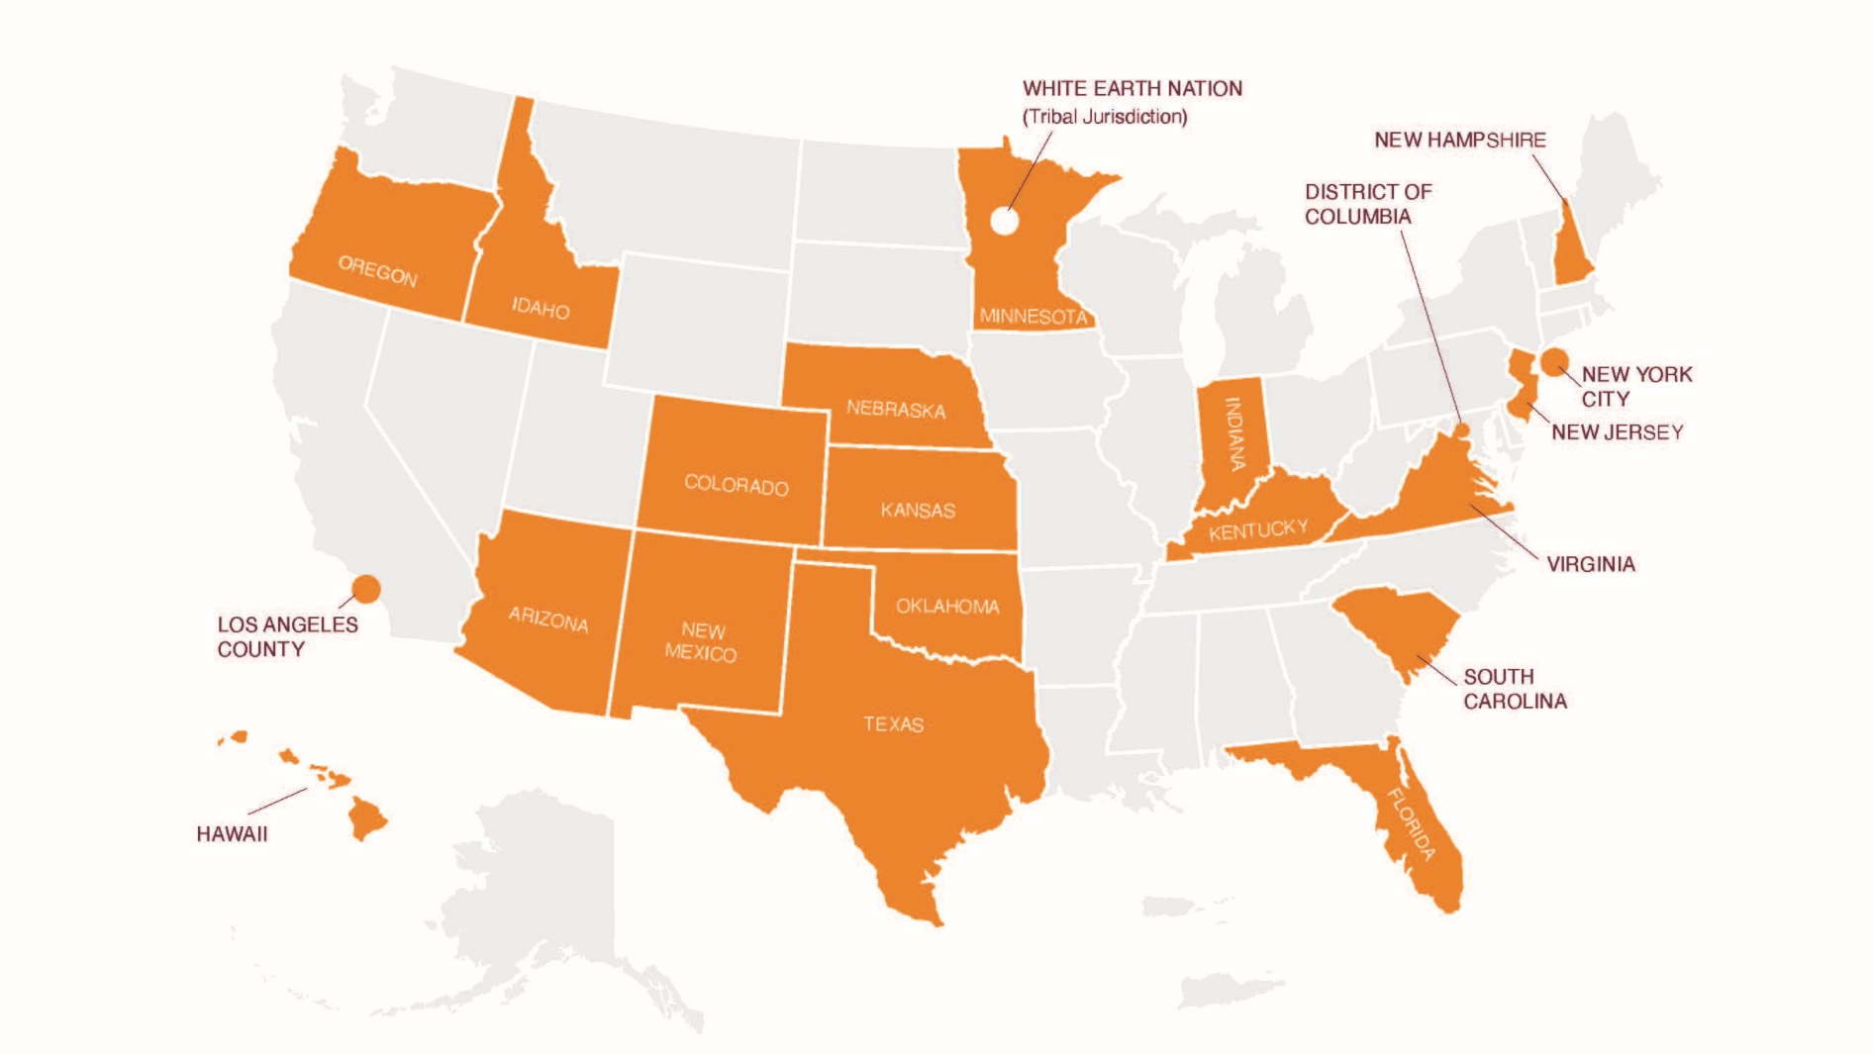
National TFSC Jurisdiction Map

Slide 11
Affiliated Organizations
Brevard CARES
BRITE Consulting
Casey Family Programs
Cetera, Inc.
Champions for Children
Children's Board of Hillsborough Co.
Children's Home Society
Citrus Family Care Network
Community Foundation of Sarasota County
Community Partnership for Children
Families First Network
Family Support Services
Florida Behavioral Health Association
Florida Coalition for Children
Florida Department of Children & Families
Florida Department of Health - Circuit 12
Florida Institute for Child Welfare
Guardian at Litem - State of Florida
Heartland for Children
Heroes Network
Mining For Gold
NAMI Sarasota Manatee
National Center for Innovation & Excellence
Partnership for Strong Families
Prevent Child Abuse
Safe Children Coalition
Safe Families for Children – Florida
Selfless Love Foundation
Sunshine Health
Volusia Healthy Start Coalition

